Slide 1
DSP Lab. Week 1 Drawing sinusoidal waves
Kyuheon Kim
Media Lab. Rm567
kyuheonkim@khu.ac.kr
Last update : August 24, 2019

Slide 2
SIGNAL TYPES
Sampling
ANALOG/ELECTRONIC:
Circuits: resistors, capacitors, op-amps
x(t)
ELECTRONICS
y(t)
DIGITAL/MICROPROCESSOR
Convert x(t) to numbers stored in memory
x(t)
A-to-D
x[n]
COMPUTER
y[n]
D-to-A
y(t)

Slide 3
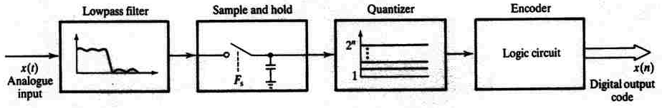
SIGNAL TYPES
Sampling
x(t)
A-to-D
x[n]
COMPUTER
y[n]
D-to-A
y(t)
A-to-D
Convert x(t) to numbers stored in memory
D-to-A
Convert y[n] back to a “continuous-time” signal, y(t)
y[n] is called a “discrete-time” signal

Slide 4
Sampling x(t)
Sampling
SAMPLING PROCESS
Convert x(t) to numbers x[n]
“n” is an integer; x[n] is a sequence of values
Think of “n” as the storage address in memory
UNIFORM SAMPLING at t = nTs
IDEAL: x[n] = x(nTs)
SAMPLING RATE (fs)
fs =1/Ts
NUMBER of SAMPLES PER SECOND
Ts = 125 microsec → fs = 8000 samples/sec
UNITS ARE HERTZ: 8000 Hz
UNIFORM SAMPLING at t = nTs = n/fs
IDEAL: x[n] = x(nTs)=x(n/fs)
x(t)
C-to-D
x[n]=
x(nT_{s})

Slide 5
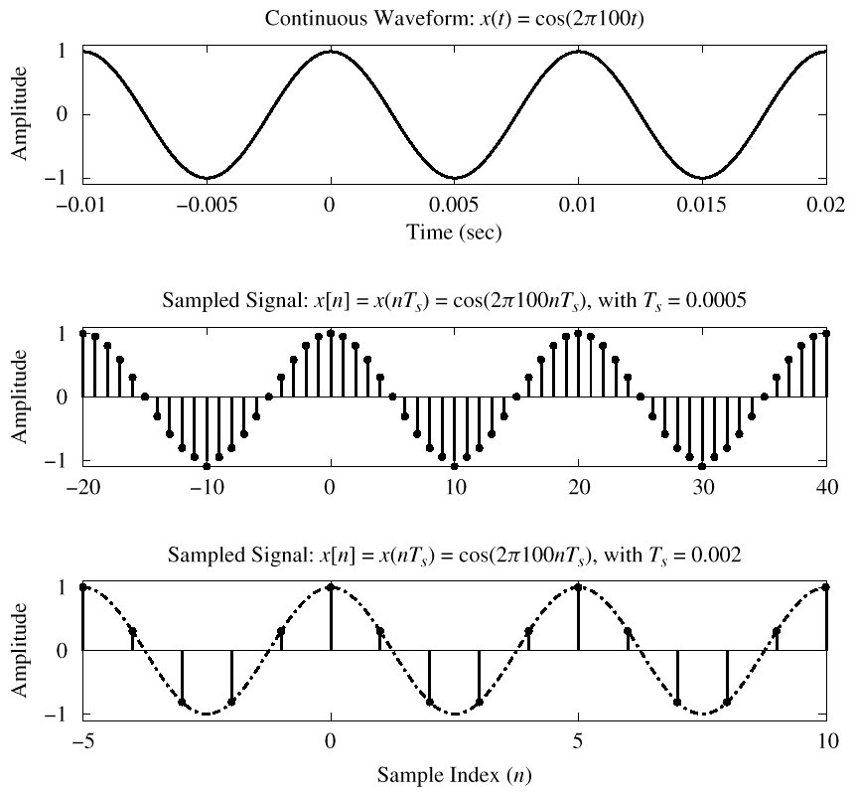
Sampling

Slide 6
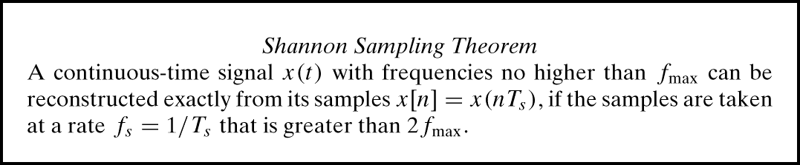
Sampling Theorem
Sampling
HOW OFTEN ?
DEPENDS on FREQUENCY of SINUSOID
ANSWERED by SHANNON/NYQUIST Theorem
ALSO DEPENDS on “RECONSTRUCTION”

Slide 7
Storing Digital Sound
Sampling
x[n] is a SAMPLED SINUSOID
A list of numbers stored in memory
EXAMPLE: audio CD
CD rate is 44,100 samples per second
16-bit samples
Stereo uses 2 channels
Number of bytes for 1 minute is
2 X (16/8) X 60 X 44100 = 10.584 Mbytes

Slide 8
Discrete-Time Sinusoid
Sampling
Change x(t) into x[n]
DEFINE DIGITAL FREQUENCY
Called as Normalised Radian frequency

Slide 9
Digital Frequency $\hat{w}$
Sampling
VARIES from 0 to 2π, as f varies from 0 to the sampling frequency
UNITS are radians, not rad/sec
DIGITAL FREQUENCY is NORMALIZED

Slide 10
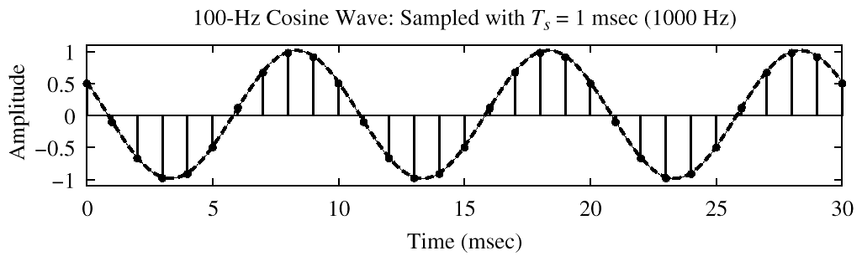
Spectrum (Digital)
Sampling
–0.2π
2π(0.1)

Slide 11
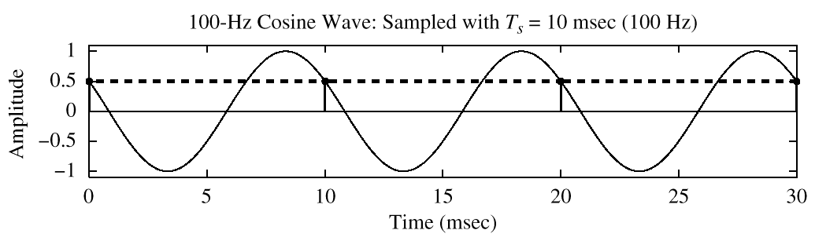
Spectrum (Digital) ???
Sampling
?
–2π
2π(1)

Slide 12
The REST of the STORY
Sampling
Spectrum of x[n] has more than one line for each complex exponential
Called ALIASING
MANY SPECTRAL LINES
SPECTRUM is PERIODIC with period = 2π
Because

Slide 13
Aliasing Derivation
Sampling
Other Frequencies give the same
Aliases of the frequency f with respect to the sampling frequency fs

Slide 14
Aliasing Derivation
Sampling
Other Frequencies give the same

Slide 15
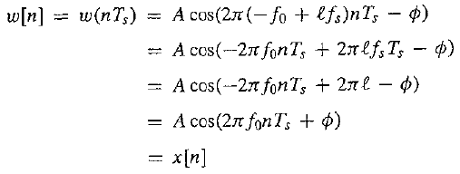
Folded Frequency
Sampling

Slide 16
Aliasing Conclusions
Sampling
ADDING f_{s} or 2f_{s} or –f_{s} to the FREQ of x(t) gives exactly the same x[n]
The samples, x[n] = x(n/f_{s} ) are EXACTLY THE SAME VALUES
GIVEN x[n], WE CAN’T DISTINGUISH f_{o} FROM (f_{o} + f_{s} ) or (f_{o} + 2f_{s} )
The frequency are callled aliases of the frequency f with respect to the sampling frequency f_{s}

Slide 17
Spectrum: Over sampling
Sampling
–1.8π
–0.2π
2π(0.1)
1.8π

Slide 18
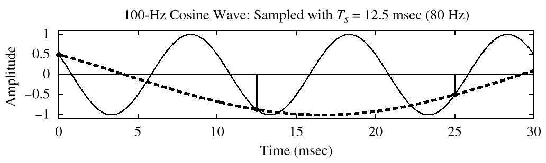
Aliasing case: Under sampling
Sampling
–2.5π
–1.5π
–0.5π
0.5π
1.5π
2.5π

Slide 19
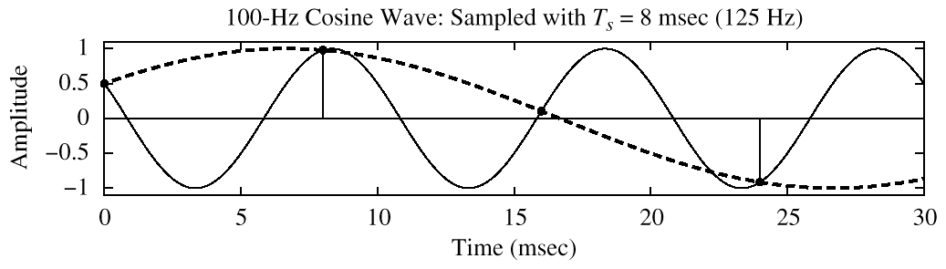
Folding case: Under sampling
Sampling
–1.6π
–0.4π
0.4π
1.6π

Slide 20
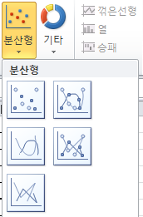
C-program (Sinusoidal wave) ex1
#include <iostream> // cout, cin
#include <fstream> // ifstream, ofstream 입출력 파일 라이브러리
using namespace std;
#define PHI 3.141592
int main(){
ofstream outFile; // 출력 파일 선언.
outFile.open("data.txt", ios::out); // 출력 파일 data.txt 열기.
float t, dt, f0;
t = 0;
dt = 1./44000.; // fs = 44000Hz smapling frequency
f0 = 440; // 440Hz signal
for(int i=0;i<400;i++,t+=dt)
outFile << t << " " << sin(2.*PHI*f0*t) << endl;
outFile.close();
return 0;
}
main Function
Return type
// 프로그램을 만드는 폴더에서 data.txt를 읽어서 excel로 그래프 그린다.
// 두 개의 열을 drag한 후, “삽입➔분산형”으로 그래프를 그린다.

Slide 21

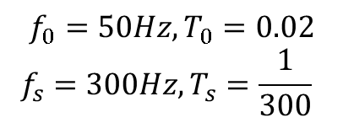
C-program (Sinusoidal wave) ex2
$$x\left(t\right)=2\cos\left(2π\left(50\right)t+\frac{π}{2}\right)+cos⁡(2π\left(150\right)t)$$
$$f_{0}=50Hz, T_{0}=0.02$$
$$f_{s}=300Hz, T_{s}=\frac{1}{300}⁡$$
#include <iostream> // cout, cin
#include <fstream> // ifstream, ofstream 입출력 파일 라이브러리
using namespace std;
#define PHI 3.141592
int main()
{
ofstream outFile; // 출력 파일 선언.
outFile.open("data.txt", ios::out); // 출력 파일 data.txt 열기.
float t = 0, fs = 300., dt = 1. / fs; // 시간, 샘플링 주파수, 샘플링 주기
int f0 = 50,n=3,smp_cnt; // 기본주파수, n개 주기 파형, 신호 샘플 개수
smp_cnt = (fs / f0)*n;
for (int i = 0; i <= smp_cnt; i++, t += dt)
outFile << t << " " << 2*cos(2.*PHI*50*t+0.5*PHI)+ cos(2.*PHI*150*t)<< endl;
outFile.close();
return 0;
}
n주기 파형, $n×T_{0}= {(신호 샘플 개수) ×T}_{s}$

Slide 22
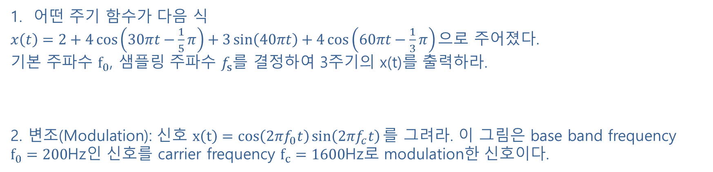
Week 1 assignment
어떤 주기 함수가 다음 식
$x\left(t\right)=2+4\cos\left(30πt−\frac{1}{5}π\right)+3\sin\left(40πt\right)+4\cos\left(60πt−\frac{1}{3}π\right)으$로 주어졌다.
기본 주파수 $f_{0}$, 샘플링 주파수 $f_{s}$를 결정하여 3주기의 x(t)를 출력하라.
2. 변조(Modulation): 신호 $x\left(t\right)=cos\left(2πf_{0}t\right)\sin\left(2πf_{c}t\right)를$ 그려라. 이 그림은 base band frequency $f_{0}=200$Hz인 신호를 carrier frequency $f_{c}=1600$Hz로 modulation한 신호이다.

Slide 23
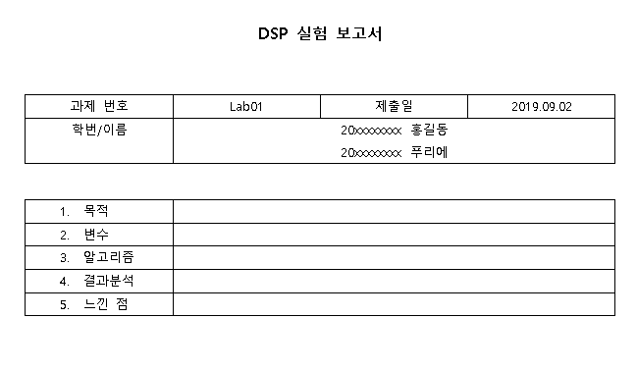

Week 1 assignment
“KLAS에 제출할 때 다음 사항을 꼭 지켜주세요”
파일명 : “Lab00_요일_대표자이름.zip”
Ex) Lab01_목_홍길동.zip (압축 툴은 자유롭게 사용)
2. 제출 파일 (보고서와 프로그램을 압축해서 제출)
- 보고서 파일 (hwp, word): 이름, 학번, 목적, 변수, 알고리즘(순서), 결과 분석, 느낀 점
- 프로그램
C++ 프로그램 파일
보고서
압축하여 제출

